Slide 1
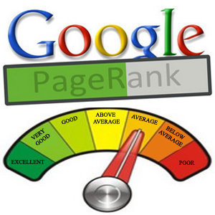
LINK ANALYSIS Algorithm Page Ranking Algorithm
Dr. A. Bhuvaneswari, VIT Chennai

Slide 2
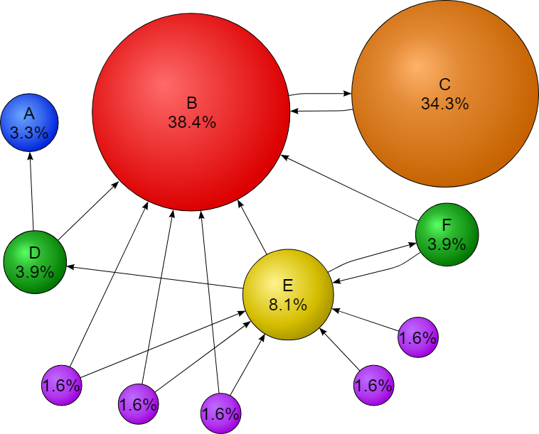
Link analysis
PageRank algorithm
PageRank algorithm
PageRank (Brin and Page, 1998) is a link analysis algorithm, which is in the basis of Google's search technology, and it is built upon the concept of eigenvector centrality
The idea of the algorithm is that information on Web can be ranked according to link
popularity: the more web pages are linked to a given web page the more popular that web page is

Slide 3
Link analysis
PageRank algorithm
PageRank algorithm
In this process of weighting web pages, not only the number of links (degree of a node) is important, but also the importance of the web pages linking to them.

Slide 4
Link analysis
PageRank algorithm
PageRank algorithm
PageRank (PR) is an algorithm used by Google Search to rank websites in their search engine results. PageRank was named after Larry Page, one of the founders of Google. PageRank is a way of measuring the importance of website pages.
According to Google:
PageRank works by counting the number and quality of links to a page to determine a rough estimate of how important the website is.
The underlying assumption is that more important websites are likely to receive more links from other websites.

Slide 5
Link analysis: hubs and authorities
2. PageRank algorithm
PageRank algorithm
Initialization: in a network of n nodes, assign a PageRank value of 1/n to each node, and choose the number of iterations k
Update the values of each node's PageRank by sequentially applying the following rule:
Basic PageRank Update Rule: divide the actual PageRank value of page
p (or node v) by the number of its outgoing links and pass these equal shares to the pages it points to. The update of a node‘s PageRank value is performed by summing the shares it receives in each iteration.
Apply this rule until the k-th iteration.

Slide 6
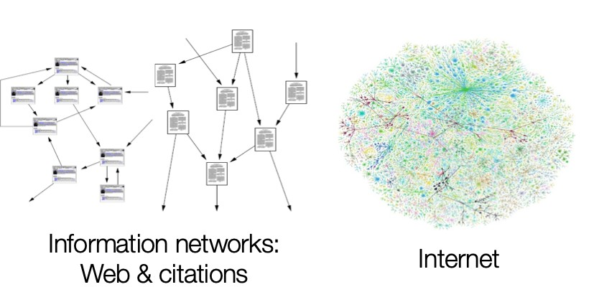
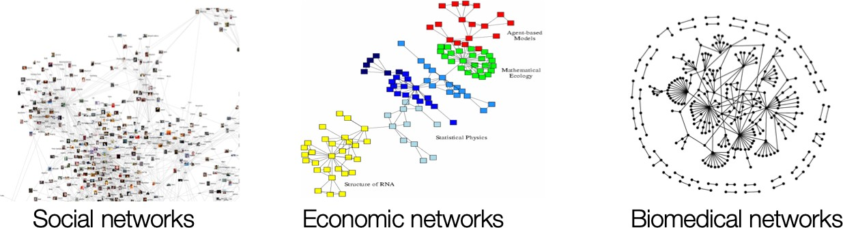
We often want to know
which nodes are important in graph.
Important nodes in graphs
Paper citation networks
Web
Who is the most influential person?
Which is the best paper?
Which is the most popular webpage?
Image from William L. Hamilton’s COMP551 special topic lecture
6

Slide 7





Important nodes in graphs
We often want to know
which nodes are important in graph.
Paper citation networks Web
^{Who is the most} Which is the best paper? Which is the most influential person? _{popular webpage?}
Image from William L. Hamilton’s COMP551 special topic lecture 5
Q.
How can we compute
the importance of nodes in graph?
A. Link analysis can help you!!

Slide 8
What do we learn today?
PageRank
Topic-sensitive PageRank
8

Slide 9
1
Google introduced a new method to evaluate webpages
PageRank
9

Slide 10
Based on graph structure,
PageRank evaluates and ranks webpages
The objective of PageRank
Importance Ranking
A
B
node B
node D
node A
node C
node E
0.40pt
0.26pt
0.20pt
C D
Web graph (Hyperlink structure)
0.11pt
0.03pt
E
10

Slide 11
Simple method to evaluate webpage importance
Simple assumption (majority voting)
If a webpage is linked by a lot of webpages, the webpage can be important.
A
B
#in-links = 3
#in-links = 2 C
D #in-links = 2
E
11

Slide 12


Simple method to evaluate webpage importance
Simple assumption (majority voting)
If a webpage is linked by a lot of webpages, the webpage can be important.
A
B
#in-links = 3
#in-links = 2 C
D #in-links = 2
E
Is this assumption enough OK?
12

Slide 13
Malicious websites can easily their scores by creating ‘spam farm’ of a million pages
Problems on simple link counting (1/2)
A
B
C
D
#in-links: 2
E
13

Slide 14
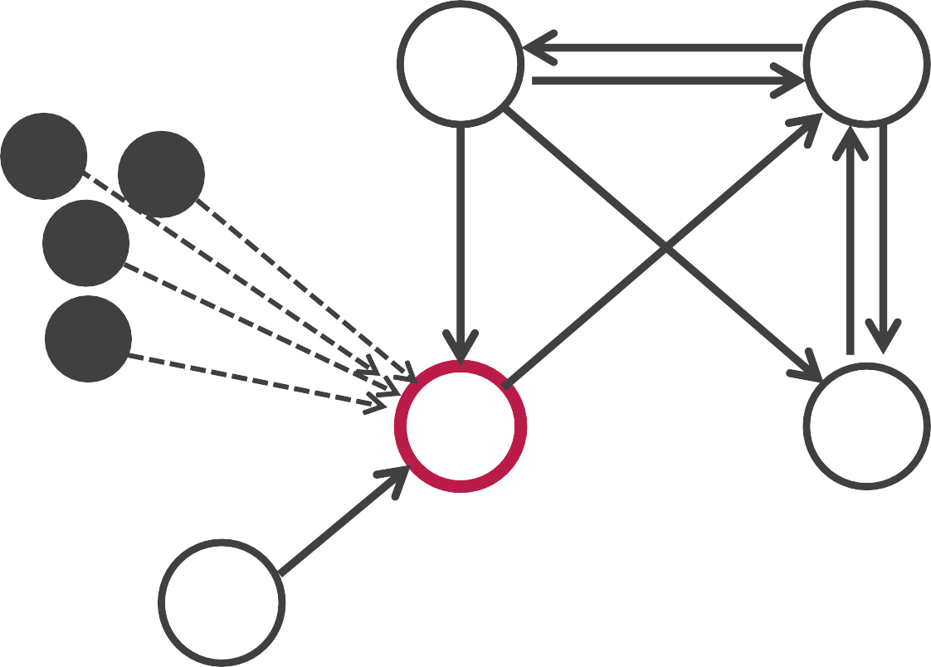
Malicious websites can easily their scores by creating ‘spam farm’ of a million pages
Problems on simple link counting (1/2)
Spam farm (98 pages)
A
B
M
M
M
M
M
M
C D
#in-links: 2 ⇒ 100
E
14

Slide 15

Simple method doesn’t consider whether where a webpage is linked by
important pages or non-important pages
Problems on simple link counting (2/2)
A
B #in-links: 3
#in-links: 2
linked by B whose #in-link=3
#in-links: 2
C D
linked by E whose #in-link=0
E
Which is more important, node C or D?₁₃

Slide 16
Basic idea of PageRank
Assumption
If a page is linked by a lot of IMPORTANT pages, the page can be important
A B
more important than E
#in-links: 2
C D #in-links: 2
E
D is more important than C
because D is linked by more important node (B) than D

Slide 17
_{1．}When people are browsing a page, we assume that
Another interpretation of basic idea of PageRank
they randomly select links in it for next browsing
People are likely to move from more important pages to a page than less important ones, following links.
People are more likely to visit more important pages
A B
With highest chance of people to visit!!
E
C D
How can we calculate the likelihood to visit?

Slide 18
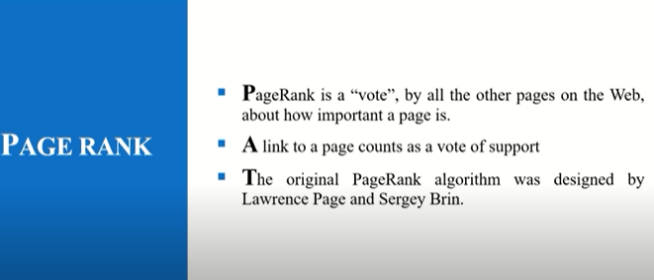

Slide 19
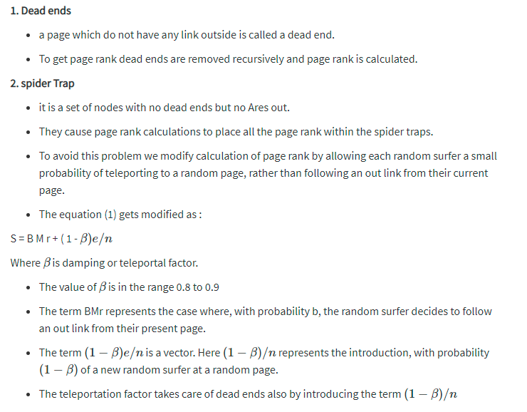
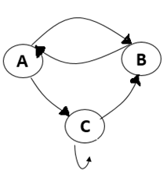
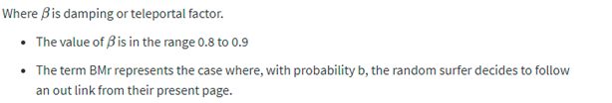

Slide 20
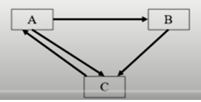
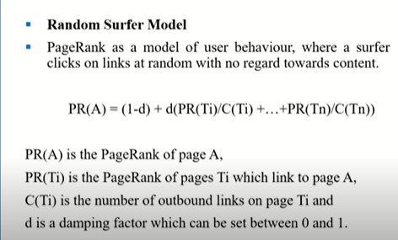

Slide 21
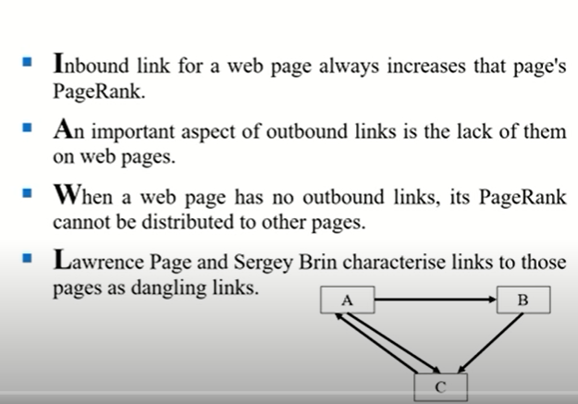

Slide 22
Iteration 1
I

Slide 23
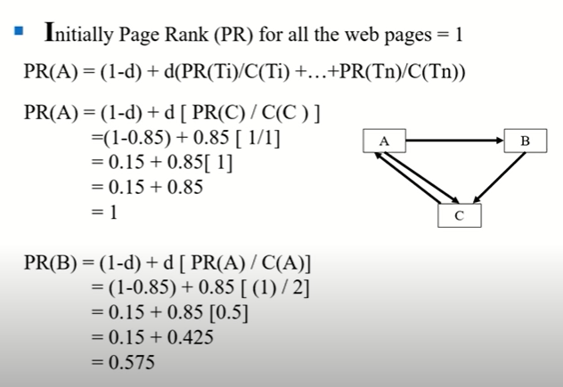
Assume Teleport value = 0.85

Slide 24
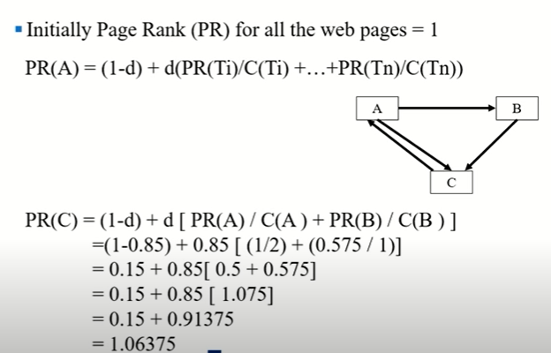

Slide 25
Iteration 2
I

Slide 26
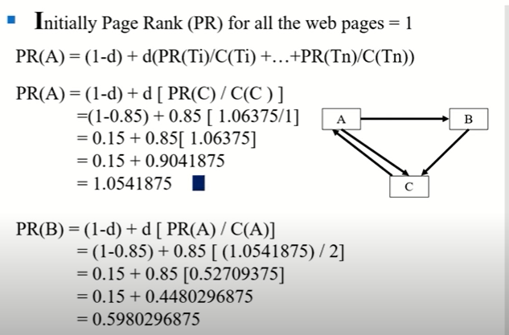

Slide 27
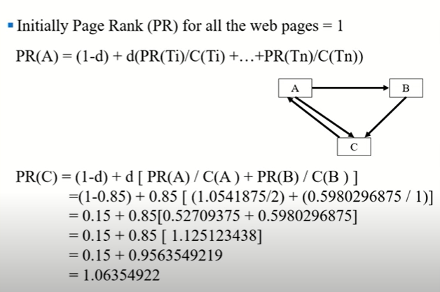

Slide 28
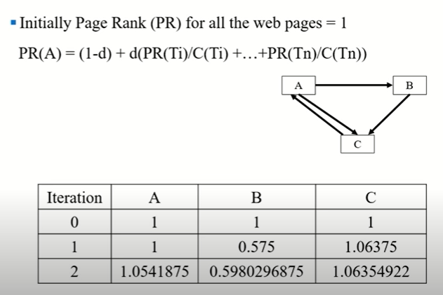

Slide 29
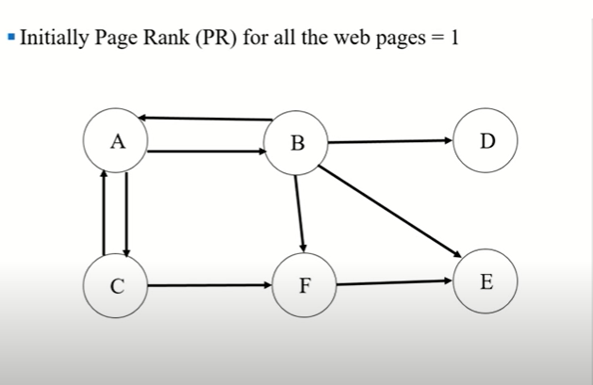

Slide 30
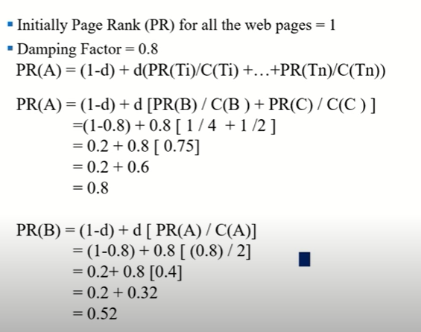
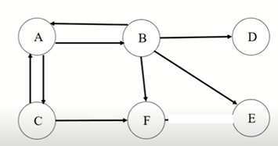

Slide 31
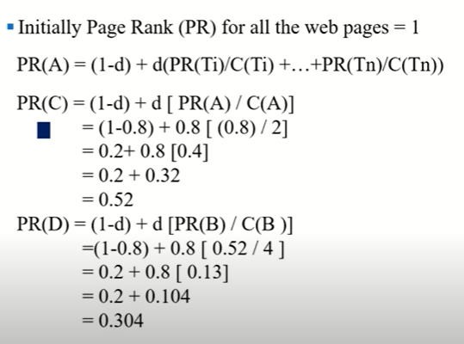

Slide 32
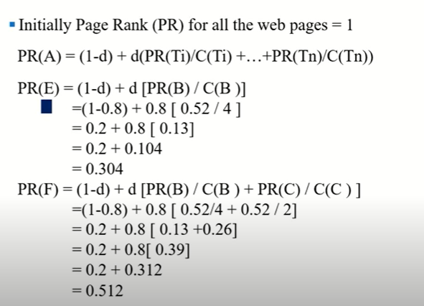

Slide 33
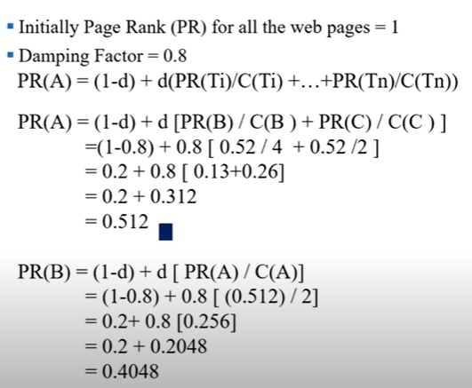

Slide 34
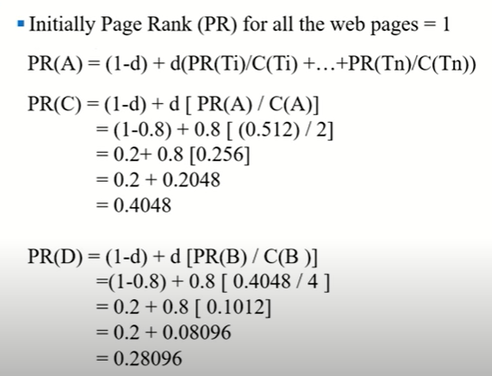

Slide 35
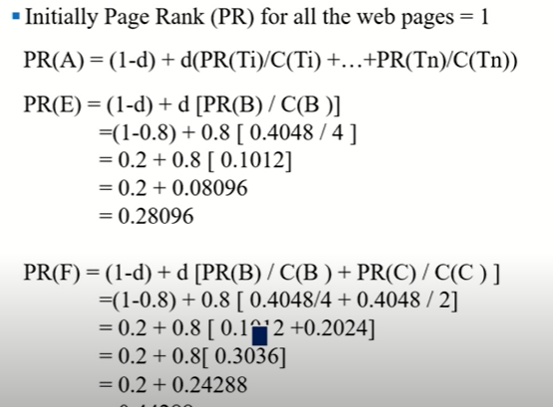

Slide 36
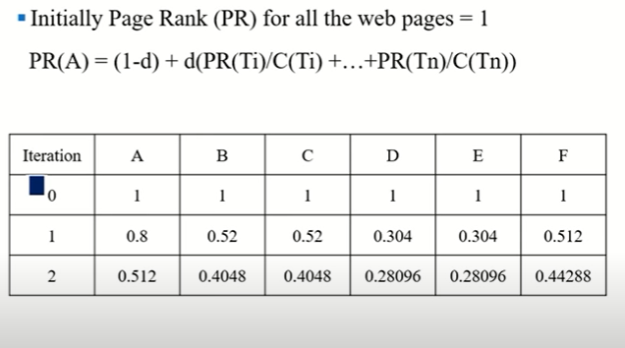

Slide 37
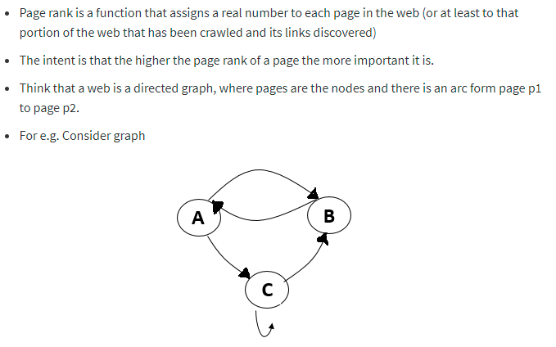

Slide 40
2
Improved PageRank to consider node’s topic
Topic-sensitive PageRank

Slide 41
Normal PageRank ignores what kinds of topics each node is related to.
Issues of normal PageRank
Normal PageRank
G B
A
1. Page C
0.282pt
2.
3.
4.
5.
6.
7.
A 0.174pt F 0.133pt D 0.132pt B
E G
C
D
0.093pt
E
F
0.092pt
0.092pt
Pages about medicine
Pages about cosmetic
Is Page C important from the viewpoint of medicine?₄₃

Slide 42
Many pages link to C, but only one of them is about med. A is linked by more pages about medicine than C
Which node is the most important about medicine?
G
A
B
C
D
E
F
Pages about medicine
Pages about cosmetic
44

Slide 43









We sometimes want to find important pages (nodes) about a certain topic.
Issues of normal PageRank
Normal PageRank ignores what kinds of topics each node is related to.
Normal PageRank
G A B
1. Page C 0.282pt
2. A 0.174pt
3. F 0.133pt
^{C D} 4. D 0.132pt
5. B 0.093pt
^{E F} 6. E 0.092pt
■ Pages about medicine _{7. G 0.092pt}
■ Pages about cosmetic
Is Page C important from the viewpoint of medicine?₄₅
If people often move to a page from important pages about the topic, such page should be important for the topic!

Slide 44
Normal PageRank
Assumption of Topic-sensitive PageRank
People follow links in pages to visit other pages.
They sometimes randomly visit pages without links.
Any kinds of
Topic-sensitive PageRank
People follow links in pages to visit other pages.
They sometimes randomly visit pages without links.
only a kind of

Slide 45
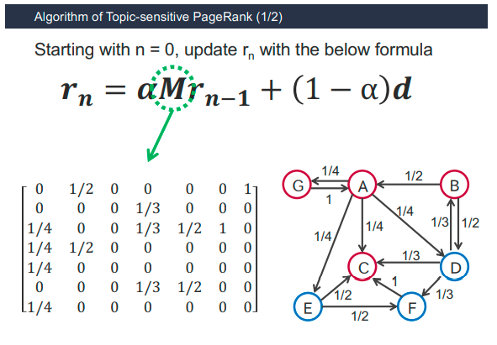

Slide 46
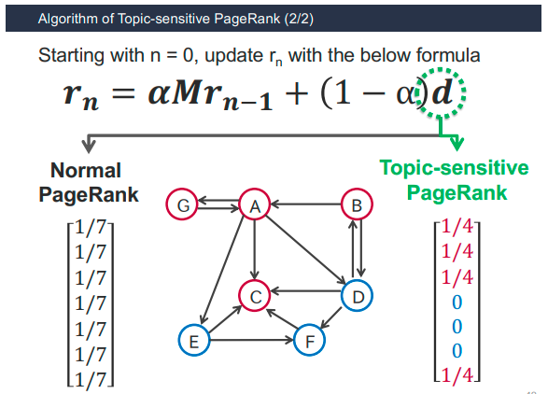

Slide 47
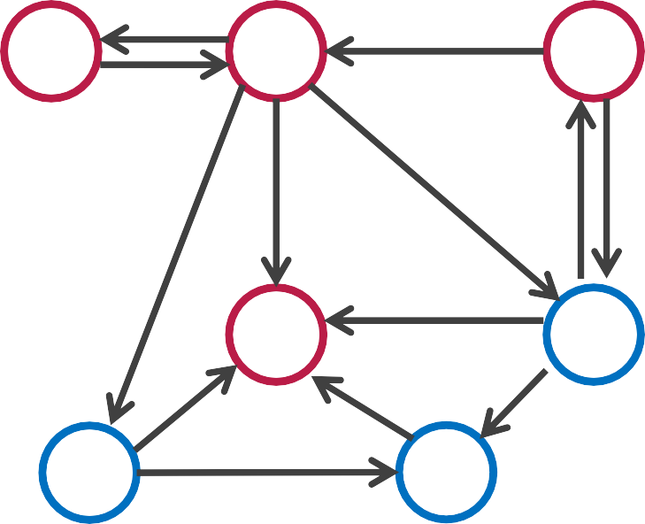
Topic-sensitive PR
Results of Topic-sensitive PageRank (TsPR)
Normal PageRank
1. C 0.282pt
A
F
D
B
E
G
G
A
B
1. A | 0.266pt
2. C | 0.248pt
3. G | 0.147pt
4. B | 0.121pt
5. D | 0.108pt
6. E | 0.057pt
7. F | 0.055pt
0.174pt
0.133pt
0.132pt
C
D
0.093pt
E F
Pages about medicine
Pages about cosmetic
0.092pt
0.092pt
TsPR gives high scores to pages about target topics
Even if a page is not about target topics, if the page
is linked by important pages, TsPR gives high scores to it.

Slide 48
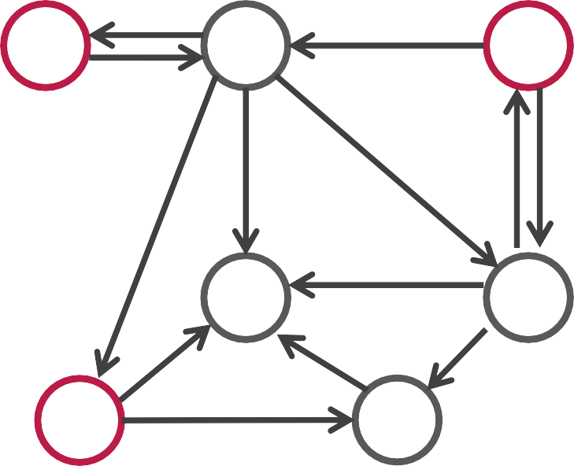

_{1.} Finding important nodes in a graph
When do we use Topic-sensitive PageRank?
for target topics
- For that, Give random surf values to only nodes for target topics
_{2.} Finding important nodes for individual
users (personalizing PageRank)
- If you know the nodes of a user to frequently visit, give random surf values to only the nodes.
G
A
B
𝒓_{𝒏} = 𝜶𝑴𝒓_{𝒏1𝟏} + 1 − α 𝒅
0
1/3
0
0
1/3
0
1/3
C
D
E F
Pages which a user likes
50

